Slide 1

by Rust Wave
Bentley University
HF 765
Fall 2015
Wudasse Berke, Steve Cumbia, Meredith Pinault, Shruti Shankar, Xu Wang
Notes:
Smart homes devices now and the future
User research (3 min)
Project focus (2min)
Design approaches (5 min)
Prototypes
Concept development
Our proposed design for Cashew (5min)
what, why, where, when and whose
Design prototype interaction (5min)

Slide 2
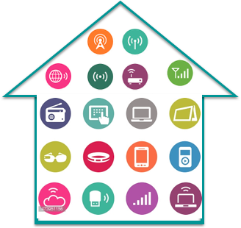
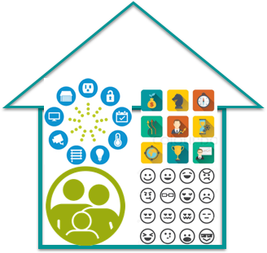
Smart Home Devices
Smart home devices use computing and web technologies to bring smartness into the home by allowing remote control and automated control. They promise better quality of life through assistive services that optimize the home environment for the users comfort.*
A variety of sophisticated smart home devices are available in the market currently but they don’t necessarily make a home “smart” because they lack:
A truly central hub
Integrated system automation and learning
Role-based access
Accommodation for exceptions
^{*Alma, Reaz and Ali, 2012}
Notes:
Smart home devices use technologies to give user more control over the things that go on in their house and take automation of mundane activities
A collection of smart home devices don’t make a smart home. A home is more than these device, it is the relationships, the activities and the memories that go about in this space and the memories that makes it a home.
In order for the home to be smart it has to integrate into the families, the relationships and the activities that take place.

Slide 3
User research
Who can benefit the most from this solution?
What are the pain points of the users and opportunities for the interface?
What are the must-haves and the nice-to-haves?
Creating the family and understanding their needs
Notes:
Through our research we were able to identify dual-income families as a demographic who could greatly benefit from a smart home system given the multitude of task they have to accomplish in the families.
Because this user group has a lot of responsibilities, they can also easily fall into the mercy of the devices in their house when they try to control them. So we choose to design for this group to alleviate some stress .

Slide 4





Personas and Use Cases
Megan, Mom
Keeping up with everything
“My husband and I have to keep up with our kid’s schedule and my family's needs changes from day to day.“
Ryan, Dad
Security, monitor, control
“The security of my family is the most important thing. I want to be able to monitor that everyone is safe.“
Julia, 15
Enjoy the entertainment system
“I like waking up to music and listen to it as I get ready, but I have to carry around my speaker and that becomes too much.”
Sasha, 9
Watch favorite videos, play games
“I don’t like wake up in the winter because it is still dark outside and I think it is not time yet so I go back to sleep.“
Guest
Security, monitor, control
Babysitter, domestic help, family member that comes in occasionally
Primary users
Secondary users
Notes:
To better understand our user group, we developed the Johnson family. Each family member have their own needs form the system but based on the type of need we were able to group them into primary and secondary user groups
Discuss family members

Slide 5

User Needs
Important
Centralized automation
Adapting to exceptions
Essential
Activities
Routines
Less device interaction
Safety and security
Relationships
Notes:
After we understood the motivation of our family members, we had to isolate out key concerns and needs they have as a family.
The essential things for them are the activities and routines that take place in their lives and the builds their relationships
Above these core attributes lies their need for the system to help them function as a family,

Slide 6
Project Focus
Allow families to interact with smart home devices to make their lives easier by helping them control their lives, not devices.
Goals:
Allow for an organic (not rigid) evolution of routines
Exceptions are really part of the routine
Easily establish new behaviors and modify existing behavior
Allow multiple, overlapping, and occasionally conflicting user goals
The smart home should know “who’s who.”
Make interacting with the smart home optional
Support routines, don’t interfere. It’s there only when you need it!
Notes:
We narrowed down our project focu and selected primary goals

Slide 7
Design Approaches
What platform can we use for the interface?
Do we show everything or can we have layers?
How much information is just enough information?
Refining the focus and iterating on prototypes
Notes:
As we developed our focus and goals we were going through multiple design iterations to test our platforms, information organization and presentation. With each iteration we were able to learn more about the family and their needs as it is mapped on to the system.

Slide 8
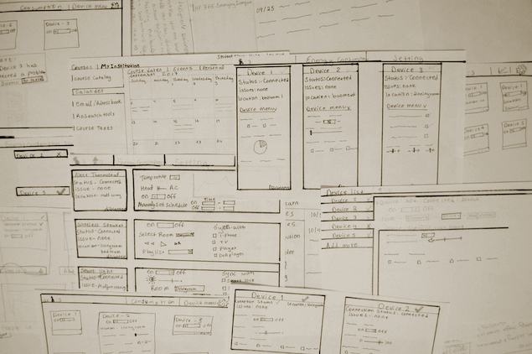
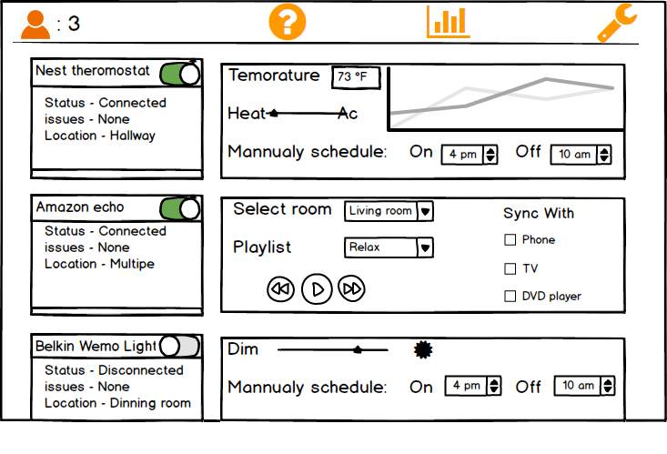
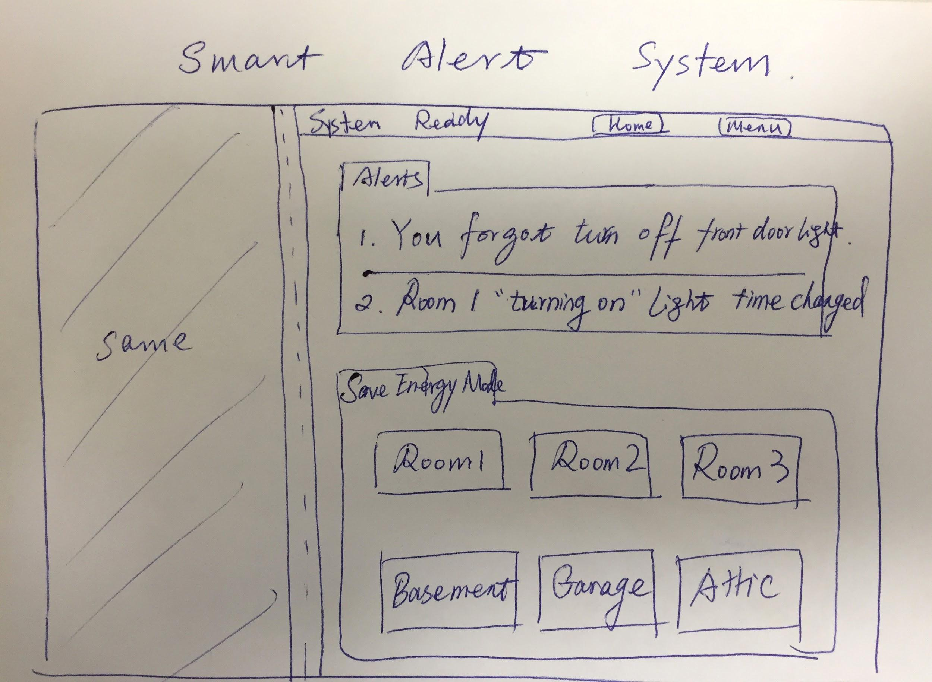
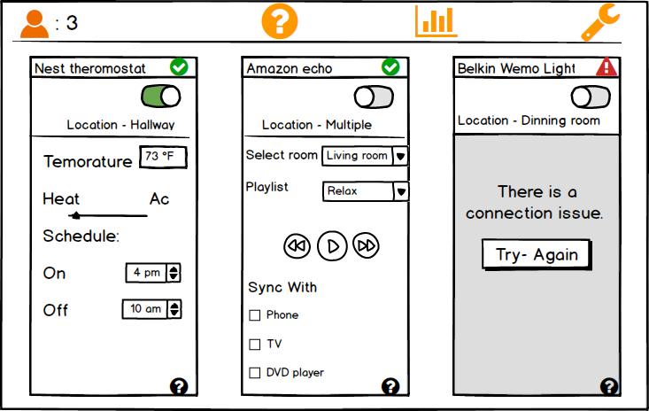
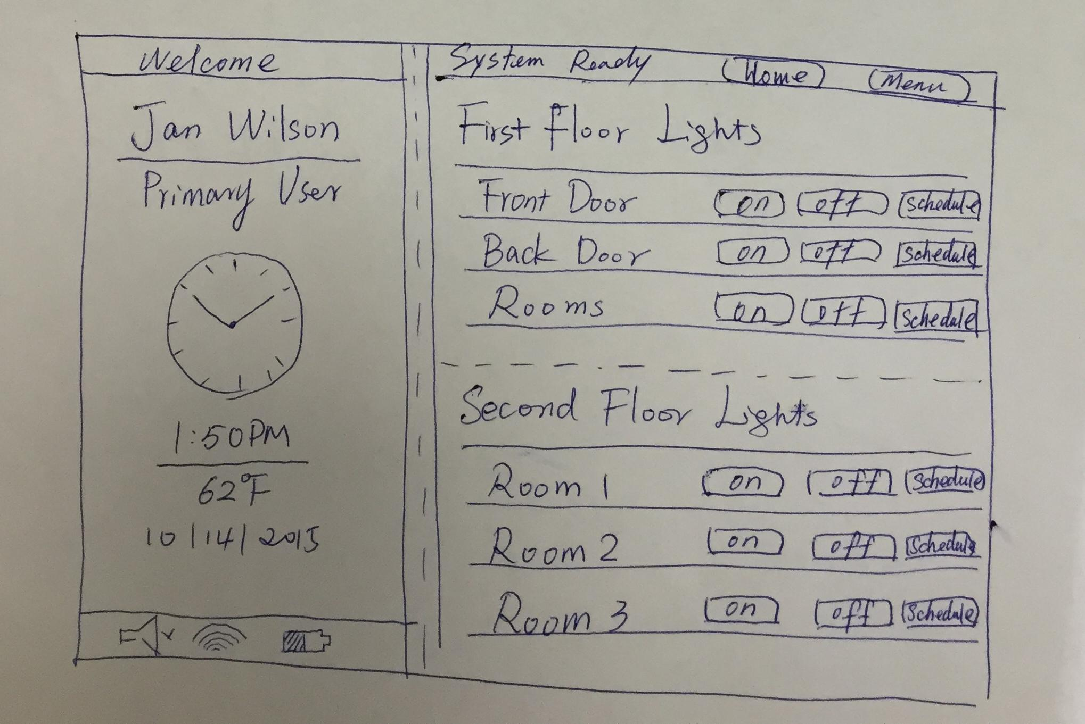
# 1 Embedded Dashboard
Takeaways
Information should be streamlined and focused on the family, not on devices.
The interface has to be accessible from more places than one.
Notes:
our initial approach was to use a dashboard display with device status, general controls to each device and information display.

Slide 9
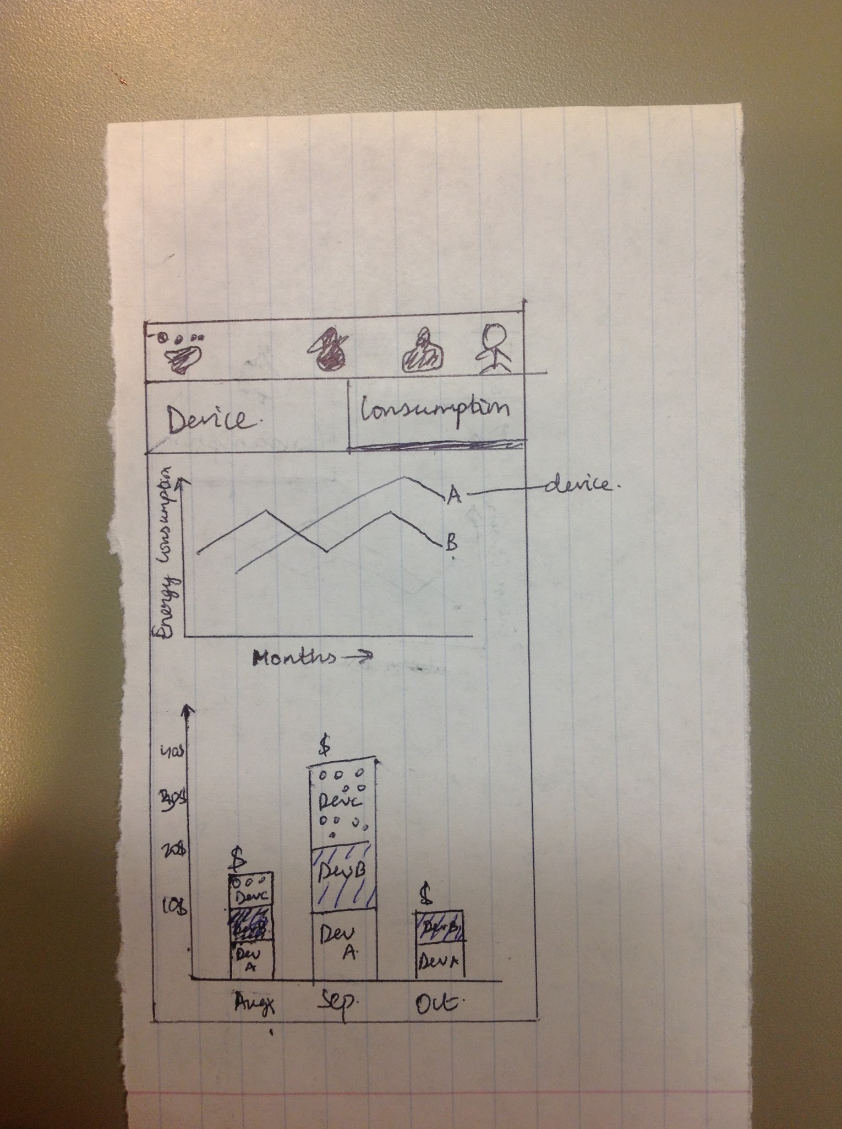
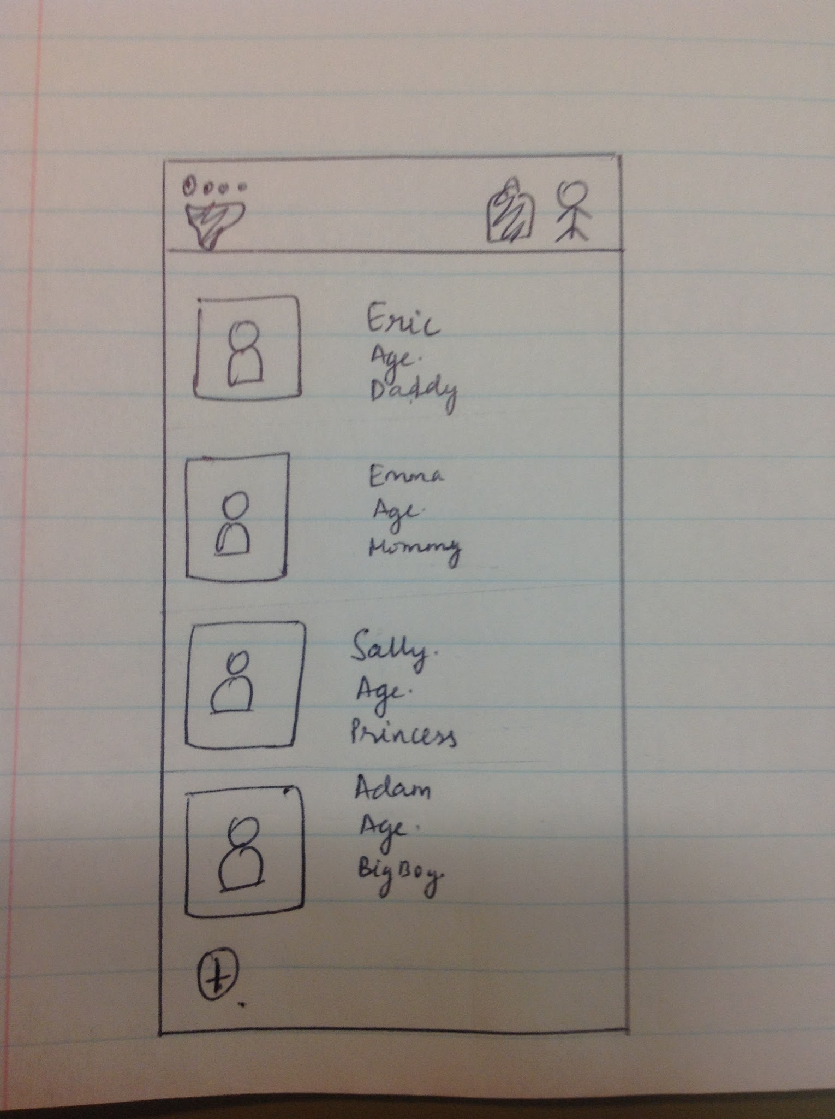
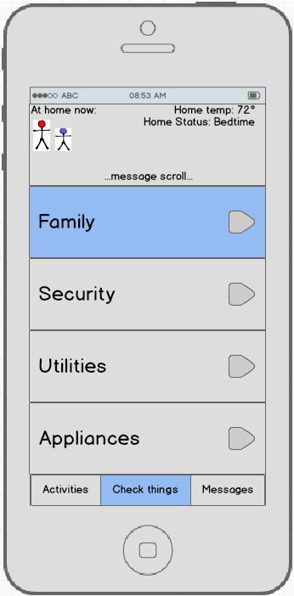
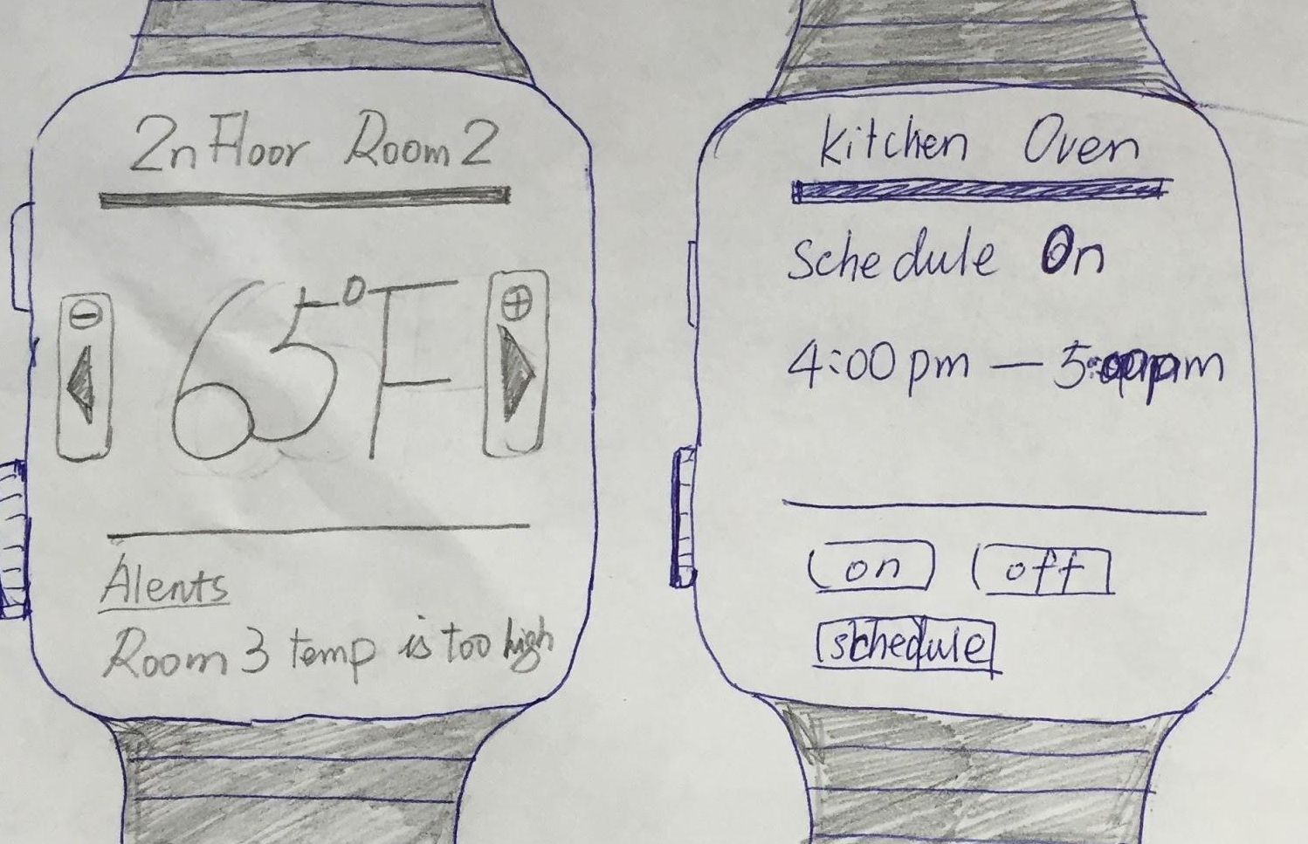
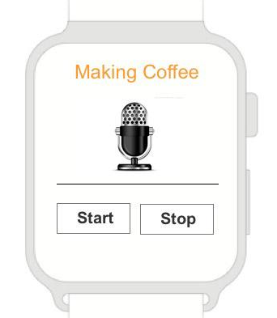
# 2 Mobile and Wearables
Takeaways
What type and how much control do families need? More automation?
Is it really necessary to add another app to an already existing collection for smart home devices?
Notes:
We also explored the possibility of a mobile design that looked at giving access to devices remotely. We this approach we came across questions

Slide 10
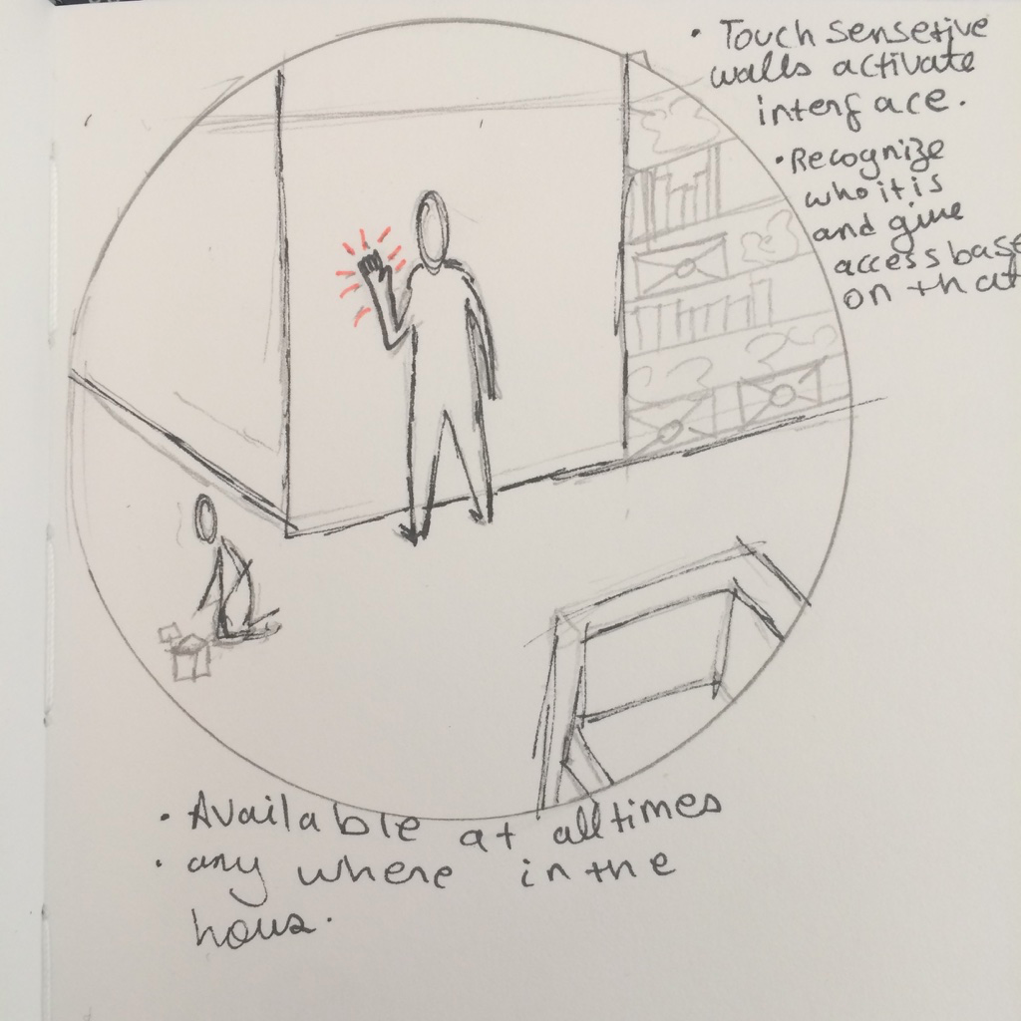
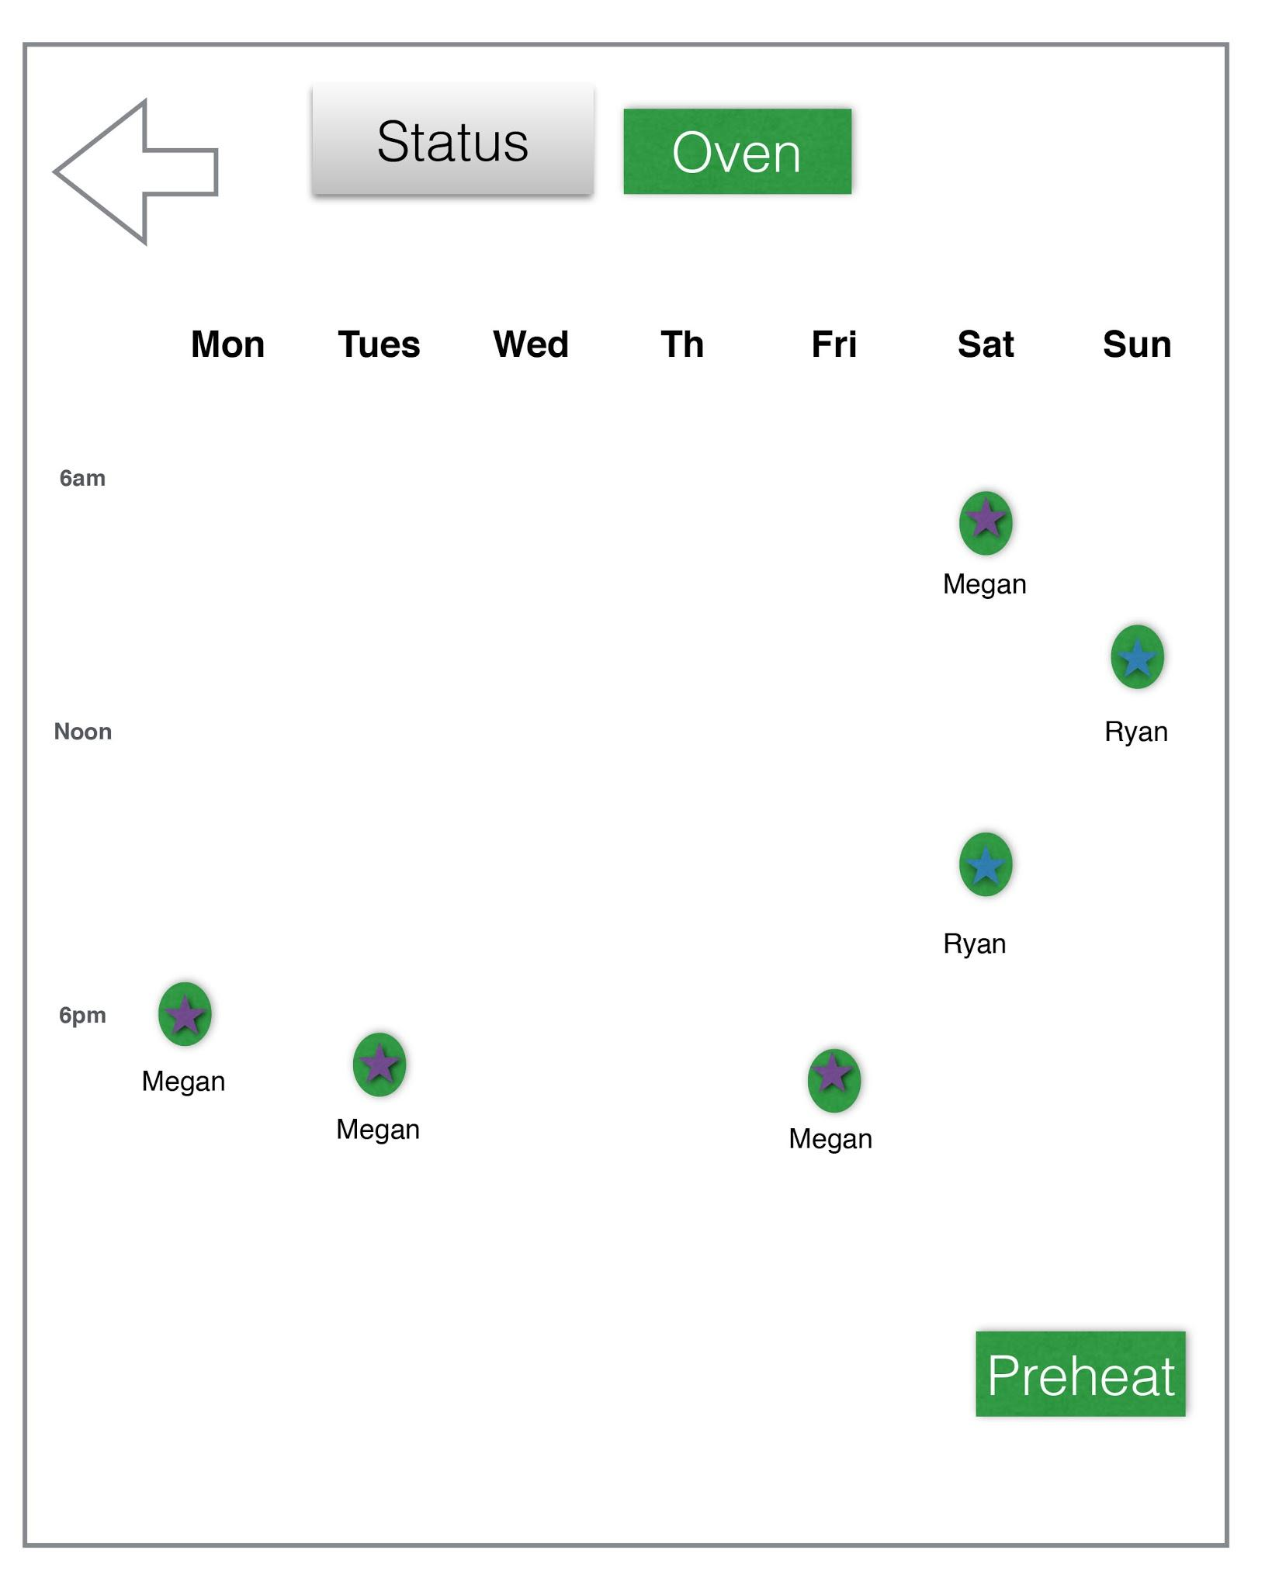
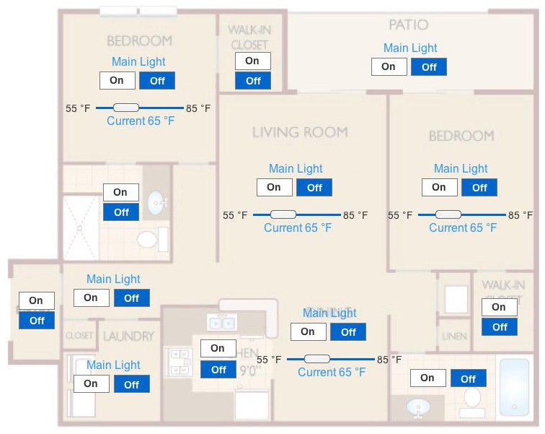
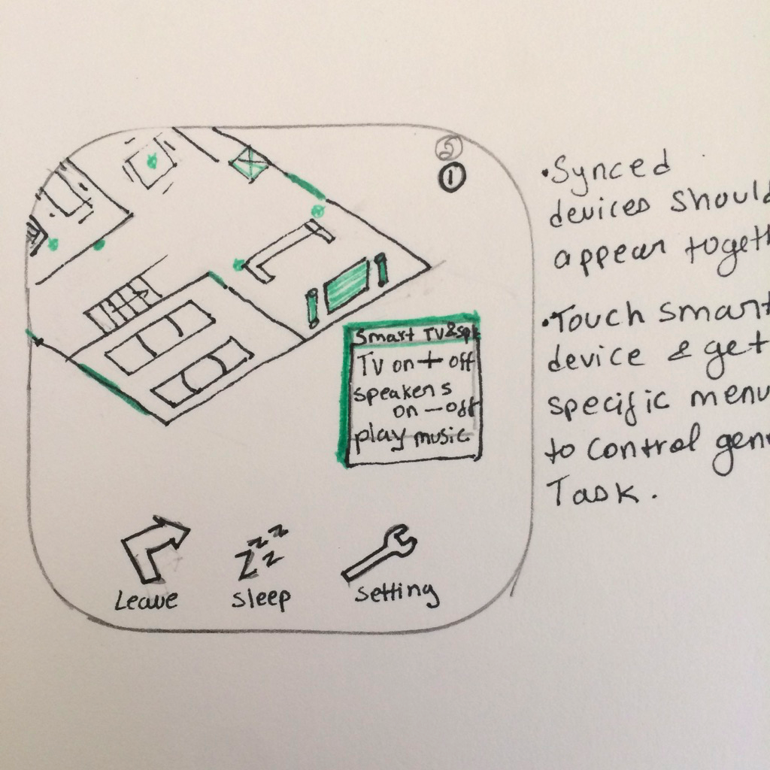
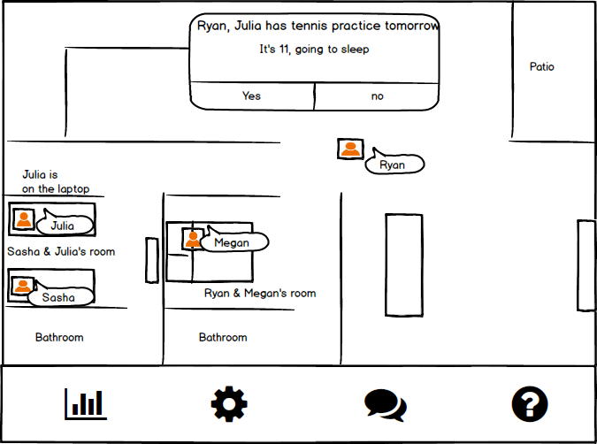
#3 Your Home in Your Home
Takeaways
Representing the home was good, but the devices are not limited to the space.
Activities and routines are more essential to families; the interface should focus on this.

Slide 11
What is Cashew all about and what can it do ?
How can it support families in their day-to-day lives?
How is it there when needed but in the background when it’s not?
A smart home lives without devices

Slide 12



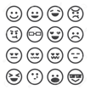
What is Cashew ?
Combining gait analysis, electronic wallpaper and learning, Cashew communicates with and integrates smart devices to create an automated system that will allow families to engage more with each other and do what makes them a family rather than devices.
Provides the right information at the right time, only when needed.
Provides a central place to control all the devices from a customized interaction
Connects different device in a sequence of events to facilitate easy one touch completion of tasks.
Learns patterns but adjusts to changes or new presences in the house.
Shows warnings rather than alerts.

Slide 13
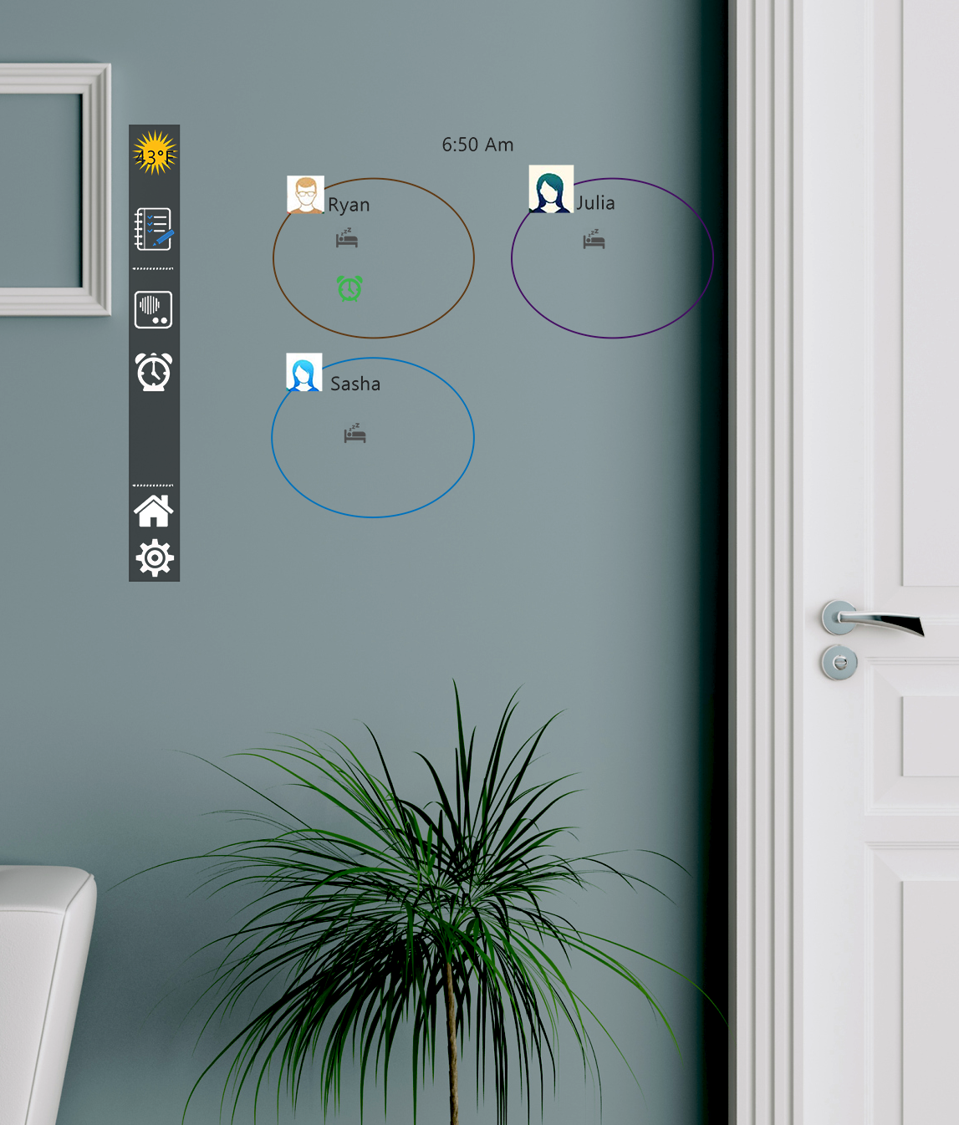
What Can Cashew Do?
Throughout the day, Cashew provides users with tools to make their lives easier. Major feature include:
Family - family members are basis for the interactions, provide information about them.
Schedules - the family can keep up with the activities of the day through Cashew by inputting information but also having ways to take that information and connect with points outside the system.
Communication - The family can talk to each other in the house using the intercom system. even though the system doesn’t show where the person is, it allows other to talk to them directly.

Slide 14
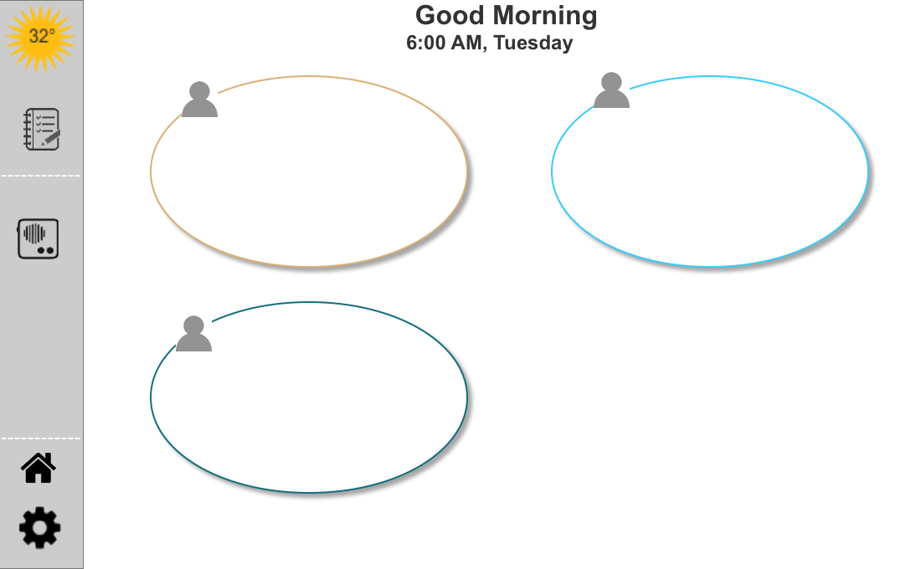
Main Display
Notes:
Explain the use of family member as the main organization system, use of the left side bar as the main navigation, movements of the icons and information changes as time goes on and priorities of activities change during the day.

Slide 15
Interactive prototype

Slide 16
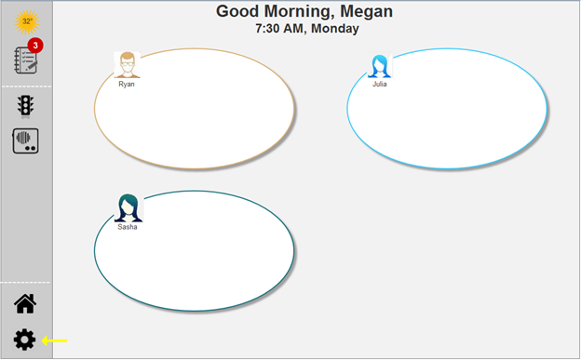
It’s Monday morning & Megan wants to change her morning setup
She wants to remove the traffic alert and add the alarms icon
She Clicks on the setup icon
Notes:
explain how to customize and go into individual smart home devices or appliances to set up.

Slide 17
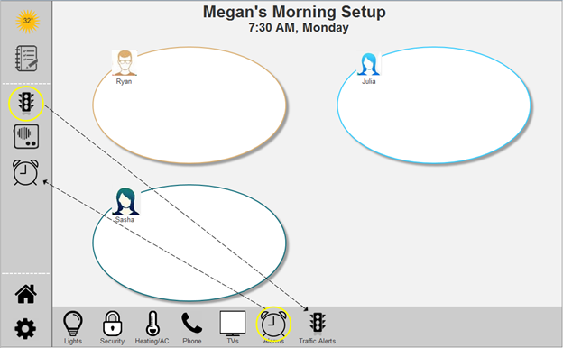
She drags the Traffic icon to the setup bar
And she drags the Alarms icon to the morning menu bar
Notes:
explain how to customize and go into individual smart home devices or appliances to set up.

Slide 18
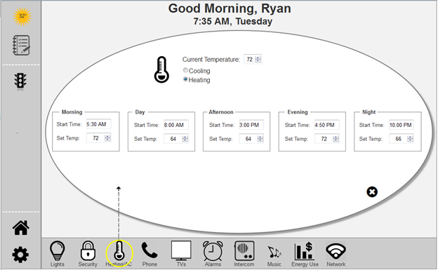
He takes a minute to check the Heat setup
He can set each time manually or have the system learn over time
Notes:
explain how to customize and go into individual smart home devices or appliances to set up.

Slide 19
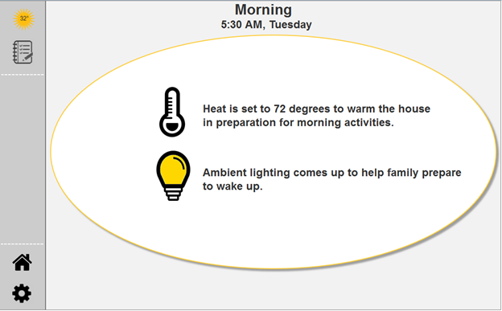
Cashew starts the morning process
Notes:
explain how to customize and go into individual smart home devices or appliances to set up.

Slide 20
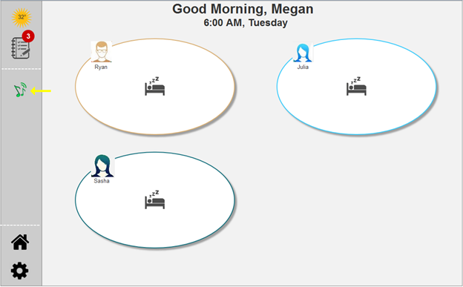
Megan’s wake up alarm goes off at 6:00 AM - It’s set to music
Once she gets up Cashew turns it off
Notes:
explain how to customize and go into individual smart home devices or appliances to set up.

Slide 21
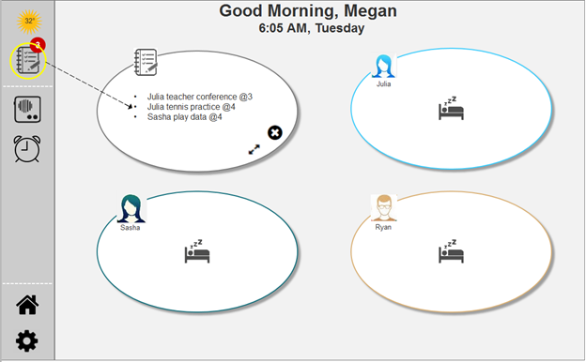
Megan does a quick check of the schedule for the day
Notes:
explain how to customize and go into individual smart home devices or appliances to set up.

Slide 22
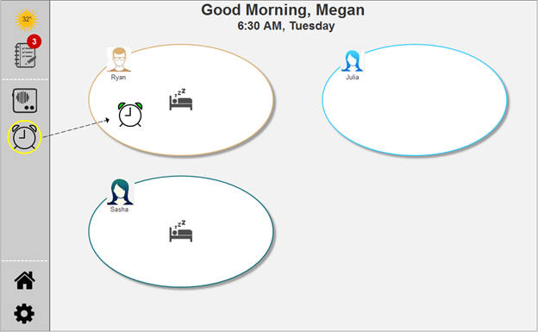
Ryan is not up yet
Megan drags the alarm into his blob
Cashew can remember to do this each morning
Notes:
explain how to customize and go into individual smart home devices or appliances to set up.

Slide 23
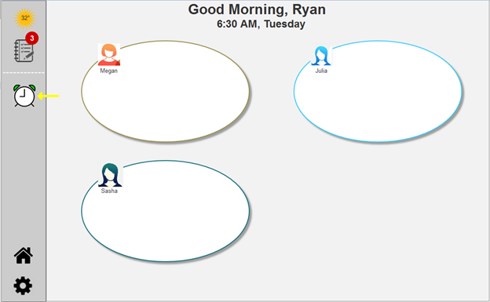
Ryan’s alarm goes off and will continue until he gets up
Notes:
explain how to customize and go into individual smart home devices or appliances to set up.

Slide 24
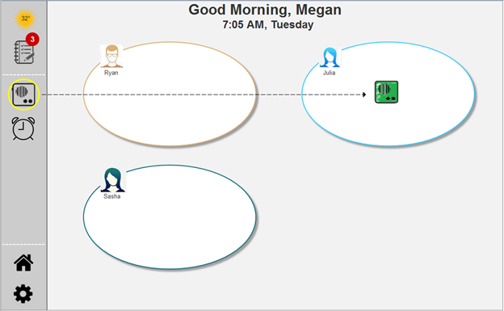
Everyone is in the kitchen having breakfast except Julia
Megan drags the intercom into Megan’s blob to tell her to hurry up
Megan doesn’t need to know exactly where Julia is because Cashew knows.
Notes:
explain how to customize and go into individual smart home devices or appliances to set up.

Slide 25
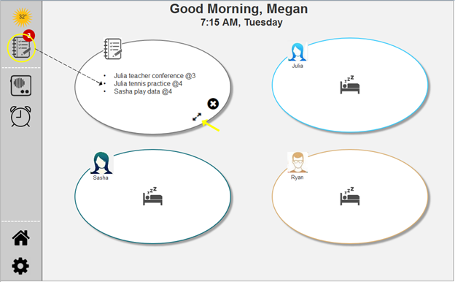
Megan and Ryan coordinate the day’s schedule
They can expand the activities blob to check details
Notes:
explain how to customize and go into individual smart home devices or appliances to set up.

Slide 26
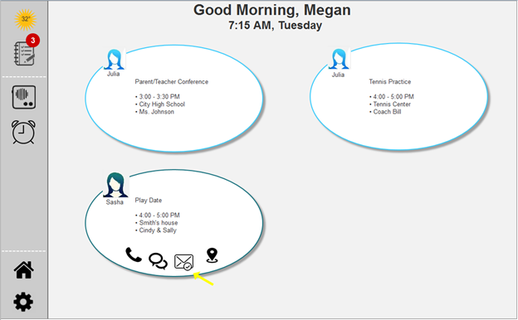
They click on Shash’s play date to show possible actions
Notes:
explain how to customize and go into individual smart home devices or appliances to set up.

Slide 27
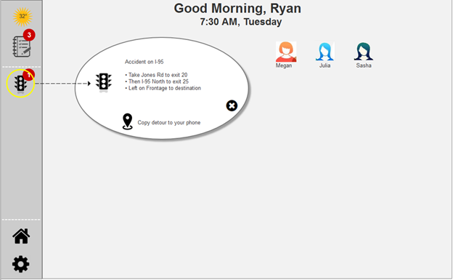
Megan leaves to take Sasha and Julia to school and to go to work
Their blobs no longer show to indicate they are no longer at home
Ryan checks the traffic alert by clicking on the traffic icon
Notes:
explain how to customize and go into individual smart home devices or appliances to set up.

Slide 28
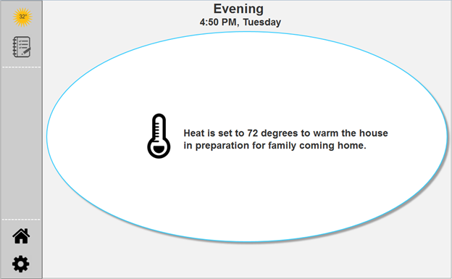
In preparation for the families return,Cashew turns on the heat
Notes:
explain how to customize and go into individual smart home devices or appliances to set up.

Slide 29
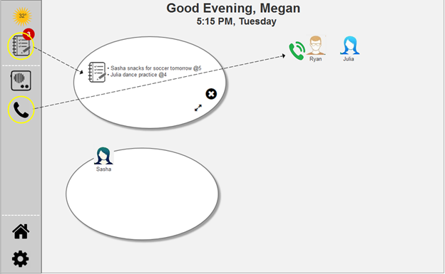
Megan does a quick check of tomorrow’s schedule and is reminded that they need to bring snacks to soccer practice tomorrow
She calls Ryan to ask him to stop at the store
Notes:
explain how to customize and go into individual smart home devices or appliances to set up.

Slide 30
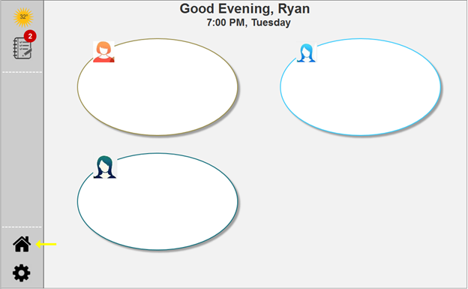
Ryan goes into the Den after dinner
He can activate the Room view by clicking on the Home icon
Notes:
explain how to customize and go into individual smart home devices or appliances to set up.

Slide 31
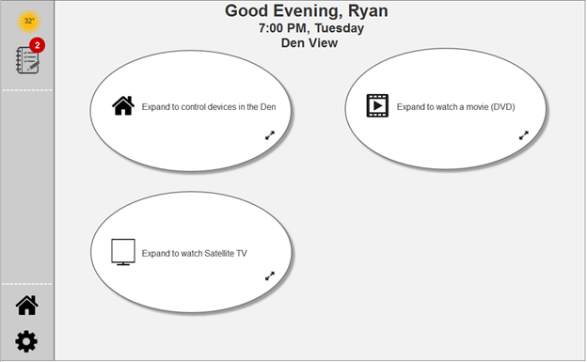
Ryan can control all the devices in the Den when in Room view
He can also run an automated action
The “Watch a Movie” action sets up all the devices appropriately and adjusts the room lighting.
Notes:
explain how to customize and go into individual smart home devices or appliances to set up.

Slide 32
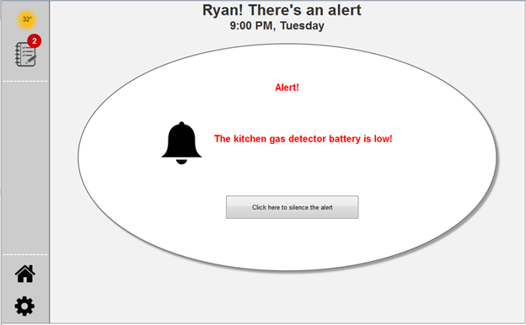
Cashew activates an alert telling Ryan the battery in the gas detector in the kitchen is low
Notes:
explain how to customize and go into individual smart home devices or appliances to set up.

Slide 33
Questions and Feedback

